Slide 1
GO Team
Business Meeting #2
Where we are – Where we’re going

Slide 2


Where We Are
Our strategic plan is the guide for the work we’re doing in the school. By monitoring the plan and ranking priorities, we can all work towards the common goals. Using the priorities in the strategic plan, the school leadership team developed a Continuous Improvement Plan (CIP) for the current school year.

Slide 3
Timeline for GO Teams
You are HERE
Fall 2021
GO Team Developed 2021-2025 Strategic Plan
1
Summer 2024
School Leadership completed Needs Assessment and defined overarching needs for SY22-23
2
August 2024
School Leadership completed 2024-2025 Continuous Improvement Plan
3
Sept. – Dec. 2024
Utilizing current data, the GO Team will review & possibly update the school strategic priorities and plan
4
Before Winter Break
GO Team will take action (vote) on the rank of the strategic plan priorities for SY24-25 in preparation for budget discussions.
5

Slide 4
Discussion Items
Current Strategic Plan
Georgia Milestones Math Data
Continuous Improvement Plan
Needs Assessment
SMART GOALS
Action Plan
Strategic Plan Alignment & Update

Slide 5
Current
Strategic Plan
2021-2025

Slide 6
Mary Lin Elementary School
Mission: Our vision is to foster students who are lifelong, proactive learners. Our students will be clear communicators who use innovative problem-solving to address the complex issues facing our community and world.
Vision: The mission of Mary Lin Elementary is to educate our students through meaningful, interdisciplinary experiences. Partnerships among students, teachers, and the community will prepare our students to be caring and creative risk-takers ready for the world.
SMART Goals
Percentage of students in grades 3-5 scoring proficient in ELA on GMAS will increase by 1% each year through 2025. Currently, MLE has 89% proficient in ELA.
Percentage of students in grades 3-5 scoring proficient in Math on GMAS will increase by 2% each year through 2025. Currently, MLE has 76% proficient in Math
Show overall growth, as determined by the State of Georgia, for at least 75% of the population in both ELA and Math on GMAS and MAP.
Increase the achievement for all lower performing subgroups within the school as measured by GMAS.
APS Strategic Priorities & Initiatives
School Strategic Priorities
School Strategies
Fostering Academic Excellence for All Data
Curriculum & Instruction Signature Program
1. Use data to inform instruction.
2. Adhere to the scope and sequence of the Georgia Standard of Excellence and supplement with other resources.
1. Hold monthly data digs led by administration.
2. Weekly lesson planning and internalization led by instructional coaches.
Created a new Equity, Diversity, and Inclusion Committee on MLE PTA.
Provide equity and anti-bias training for all staff members.
Engage students in weekly STEAM activities, Science Fair, Science Night, Spelling Bee, Math Family Night, Inclusive School’s Week, No Place for Hate Week, Red Ribbon Week, Black History Celebration, Girls on the Run, LEEP aftershool activities, and Helen Ruffin Reaching Bowl.
Administer BASC to screen for students who need additional support. Implement small group and individual couseling sessions. Dedicate 15 protected minutes for Morning Meeting and Second Step lessons that focus on social and emotional growth.
Create collaborative school culture that embraces diverse families that comprise MLE community.
Build teacher capability to meet the diverse social, emotional and academic needs of students.
Provide unique learning opportunities to cultivate students’ curiosity of learning.
Prioritize students’ social and emotional growth as a means of ensuring future success.
Building a Culture of Student Support
Whole Child & Intervention Personalized Learning
Equipping & Empowering Leaders & Staff
Strategic Staff Support Equitable Resource Allocation
Equitably align school resources with MLE mission and vision.
Mary Lin Foundation grants must be screened and approved.
Additional support staff hired (nurse, hourly intervention teachers, full-time substitutes, etc.
Provide professional learning opportunities to empower and equip teachers to work with diverse population.
Creating a System of School Support
Strategic Staff Support
Equitable Resource Allocation
Provide an environment that retains, empowers, motivates and inspires teachers to utilize their individual strengths.
System of accountability for school-based leaders.
Leadership and professional learning opportunities for all staff members based on strengths.

Slide 7
Strategic Plan
Priority Ranking
Insert the school’s priorities from Higher to Lower
Higher
Use data to inform instruction.
Create collaborative school culture that embraces diverse families that comprise MLE community.
Prioritize students’ social and emotional growth as a means to ensuring future success.
Build teacher capability to meet the diverse social, emotional and academic needs of students.
Equitably align school resources with MLE mission and vision.
Provide an environment that retains, empowers, motivates and inspires teachers to utilize their individual strengths.
Lower

Slide 8
Data

Slide 9
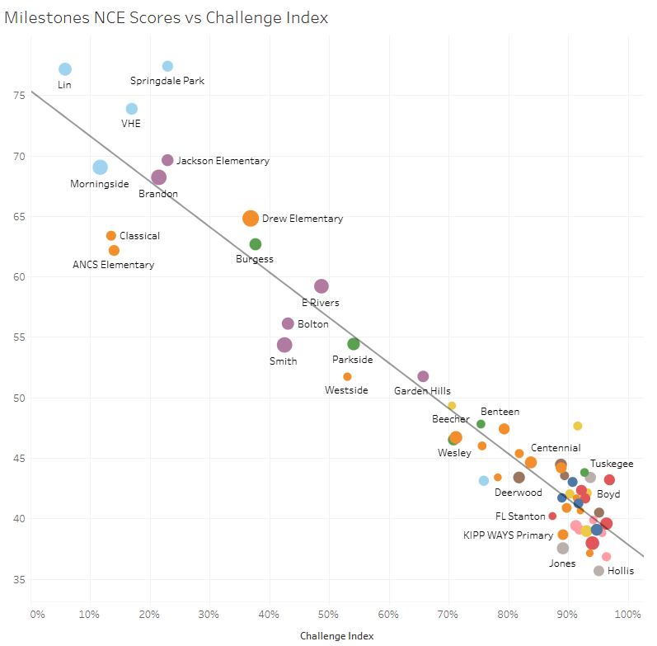
GA Milestones Math Results
If not presented at a previous GO Team meeting

Slide 10
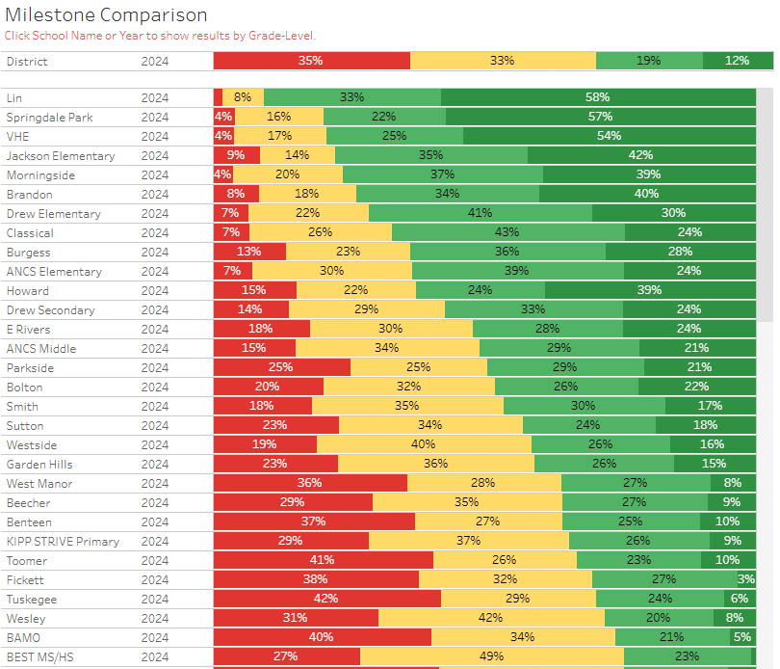
All APS
3rd, 4th, and 5th Combined Achievement
2024 Spring GMAS EOG Math

Slide 11
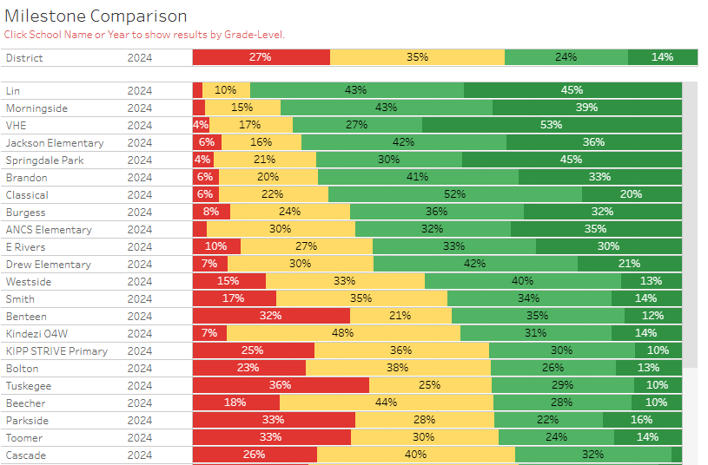
All APS
3rd grade only
Achievement
2024 Spring GMAS EOG Math

Slide 12
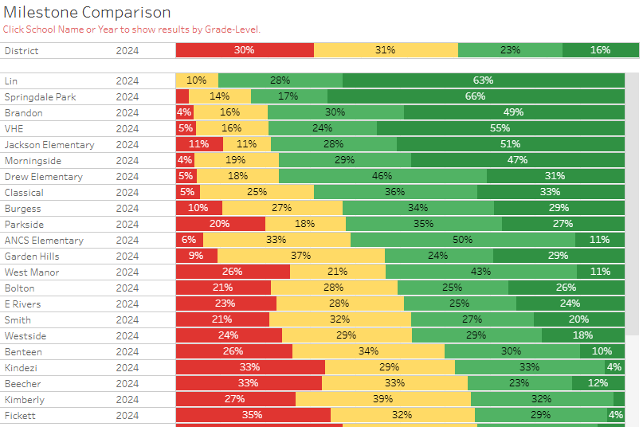
All APS
4th grade only
Achievement
2024 Spring GMAS EOG Math

Slide 13
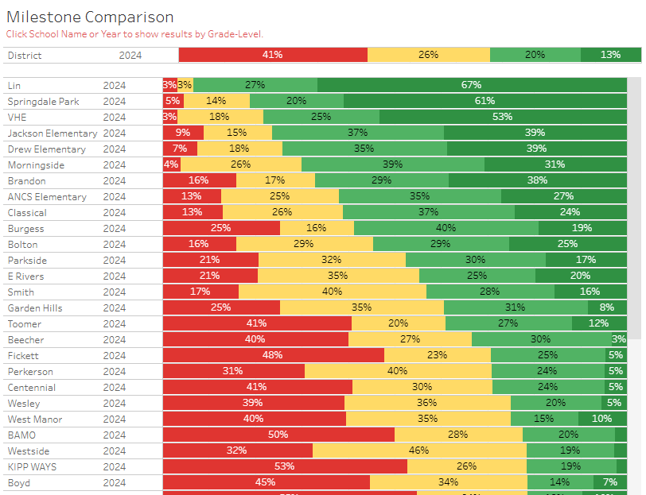
All APS
5th grade only
Achievement
2024 Spring GMAS EOG Math

Slide 14
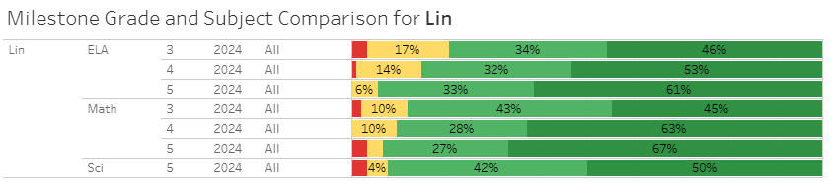
Mary Lin only
Grade-level Comparison
ELA, Math, Science

Slide 15
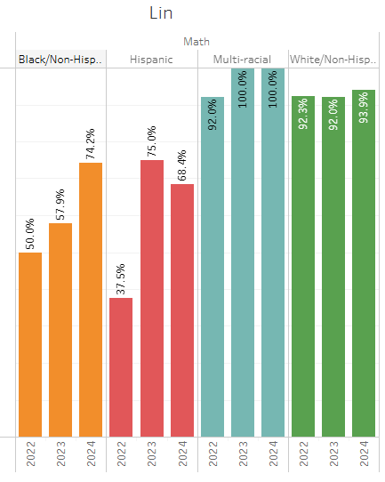
Mary Lin only
Math Ethnicity Subgroup Performance
2022, 2023, 2024
Percentage of students proficient & above.

Slide 16
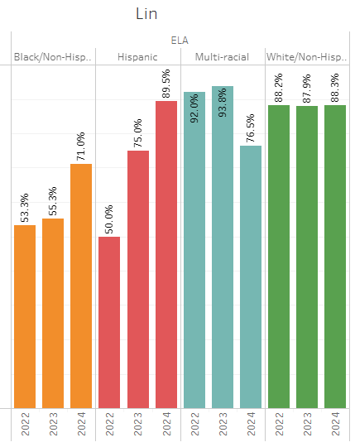
Mary Lin only
ELA Ethnicity Subgroup Performance
2022, 2023, 2024
Percentage of students proficient & above.

Slide 17
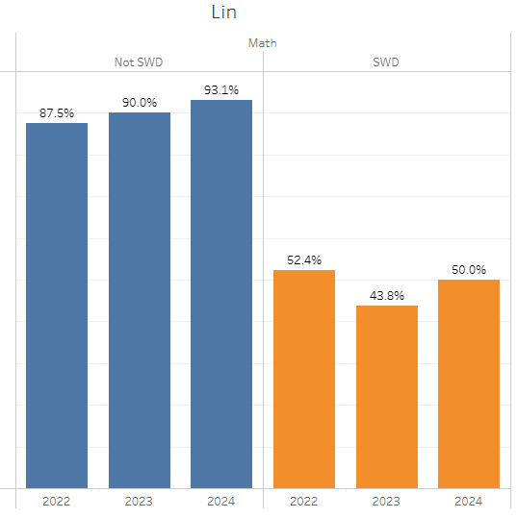
Mary Lin only
Math SWD Subgroup Performance
2022, 2023, 2024
Percentage of students proficient & above.

Slide 18
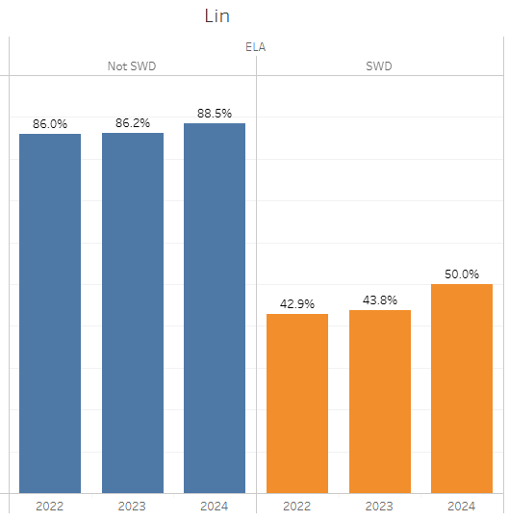
Mary Lin only
ELA SWD Subgroup Performance
2022, 2023, 2024
Percentage of students proficient & above.

Slide 19
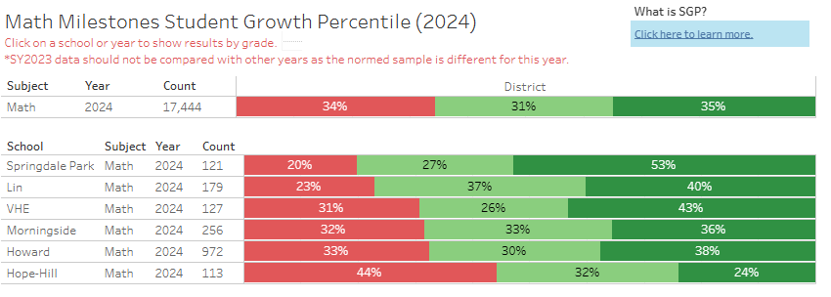
Midtown cluster only
Math Student Growth Percentiles
2024
Low (1-34)
Typical (35-65)
High (66-99)

Slide 20
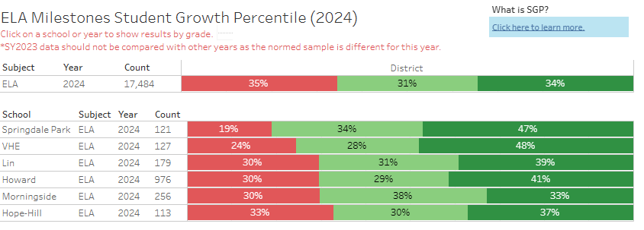
Midtown cluster only
ELA Student Growth Percentiles
2024
Low (1-34)
Typical (35-65)
High (66-99)

Slide 21

GO Team Discussion:
Data Protocol
What do you notice?
What are your wonderings?
Based on our school’s trend data from MAP assessments and end-of-year test assessments, which student sub-groups and grade levels showed the most significant gaps or unexpected trends?
Based on our school’s trend data from MAP assessments, Milestones and other indicators, are there specific trends that require more focused attention?
What additional questions do you have?

Slide 22
Continuous Improvement Plan

Slide 23
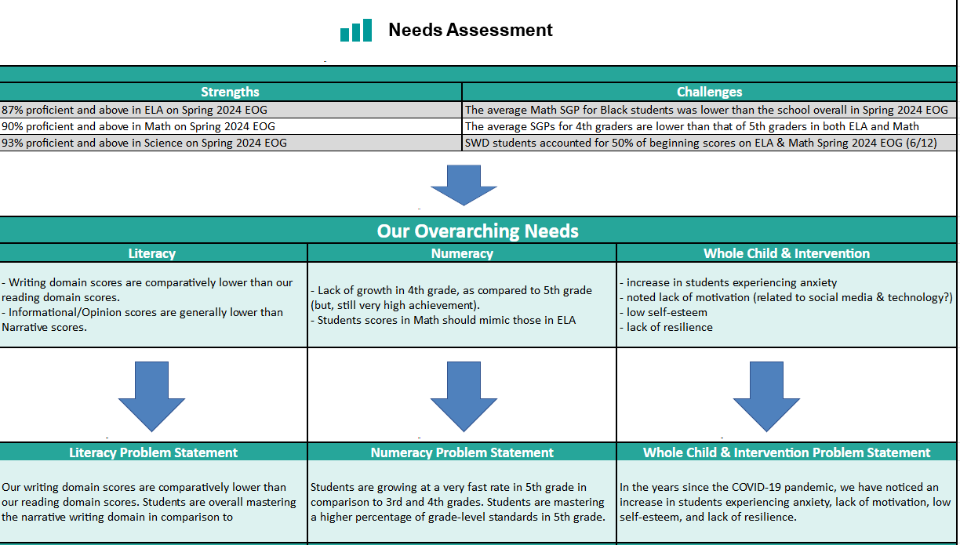
Notes:
Notes for School CIP Teams: After completing your Comprehensive Needs Assessment ( data protocol), you will come here and identify some strengths and opportunities/challenges you have observed from the data. The priority areas are Literacy, Numeracy, and Whole Child & Student Support. Identify an overarching need for each area. Formulate a problem statement for each area. Make sure the problem statement meets the criteria. Refer to your CIP resources.

Slide 24
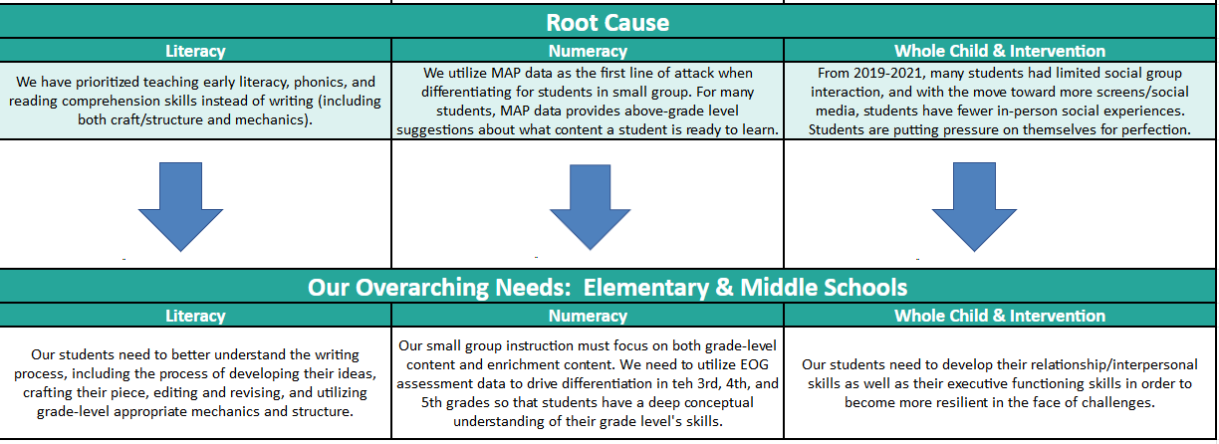
Notes:
Notes for School CIP Teams: After completing your Comprehensive Needs Assessment ( data protocol), you will come here and identify some strengths and opportunities/challenges you have observed from the data. The priority areas are Literacy, Numeracy, and Whole Child & Student Support. Identify an overarching need for each area. Formulate a problem statement for each area. Make sure the problem statement meets the criteria. Refer to your CIP resources.

Slide 25
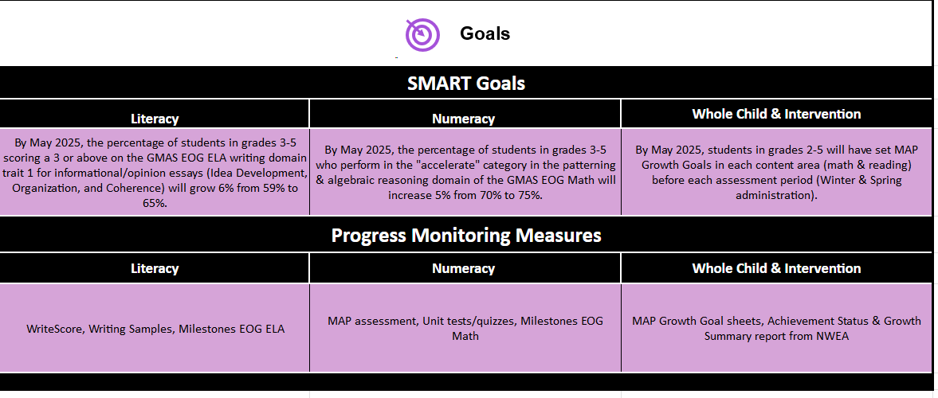

Slide 26
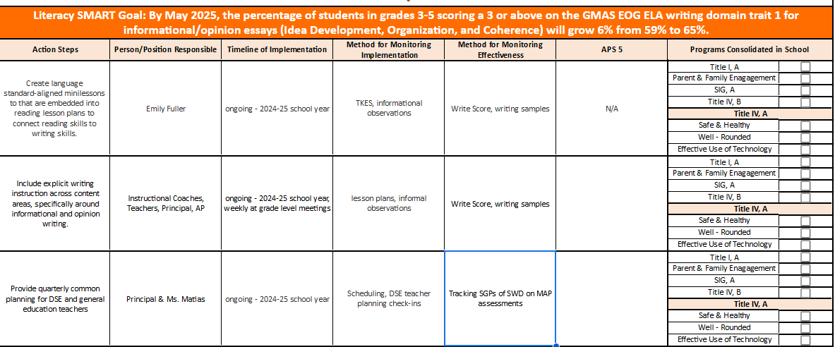

Slide 27
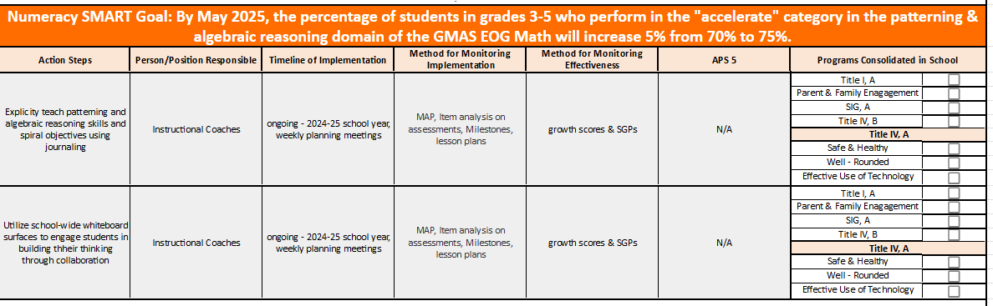

Slide 28
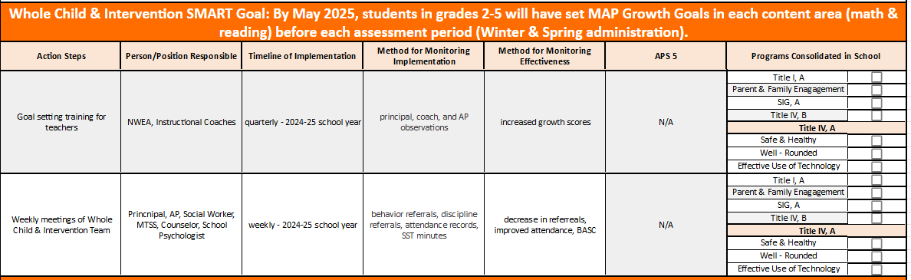

Slide 29
GO Team
Activity
&
Discussion
GO TEAM DISCUSSION: Review the priorities and goals in your strategic plan and the information and goals CIP. Reflect on if updates need to be made to the Strategic Plan.
Are all CIP Goals reflected in
our Strategic Plan Priorities?
If not, which CIP Goal(s) are missing and should be added to the Strategic Plan?

Slide 30

Updates to the
Strategic Plan
1. Use data to inform instruction with a focus on both achievement and growth.
School Strategies:
Edits to blue #3: engage students in more interdisciplinary and multi-cultural activities both during the school day and after school with a focus on STEAM integration.
Edit to blue #4: Take out the first sentence which references BASC.
Delete orange #2
Orange #3 Provide resources to teachers to both engage students in STEAM centered opportunities and serve diverse populations
Yellow #2 delete based on strengths and replace with meet their needs and interests.
SEE NEXT SLIDE FOR UPDATED STRATEGIC PRIORITIES AND STRATEGIES

Slide 31
Mary Lin Elementary School
Mission: Our vision is to foster students who are lifelong, proactive learners. Our students will be clear communicators who use innovative problem-solving to address the complex issues facing our community and world.
Vision: The mission of Mary Lin Elementary is to educate our students through meaningful, interdisciplinary experiences. Partnerships among students, teachers, and the community will prepare our students to be caring and creative risk-takers ready for the world.
SMART Goals
Percentage of students in grades 3-5 scoring proficient in ELA on GMAS will increase by 1% each year through 2025. Currently, MLE has 89% proficient in ELA.
Percentage of students in grades 3-5 scoring proficient in Math on GMAS will increase by 2% each year through 2025. Currently, MLE has 76% proficient in Math
Show overall growth, as determined by the State of Georgia, for at least 75% of the population in both ELA and Math on GMAS and MAP.
Increase the achievement for all lower performing subgroups within the school as measured by GMAS.
APS Strategic Priorities & Initiatives
School Strategic Priorities
School Strategies
Fostering Academic Excellence for All Data
Curriculum & Instruction Signature Program
1. Use data to inform instruction with a focus on both achievement and growth.
2. Adhere to the scope and sequence of the Georgia Standard of Excellence and supplement with other resources.
1. Hold monthly data digs led by administration.
2. Weekly lesson planning and internalization led by instructional coaches.
Create collaborative school culture that embraces diverse families that comprise MLE community.
Build teacher capability to meet the diverse social, emotional and academic needs of students.
Provide unique learning opportunities to cultivate students’ curiosity of learning.
Prioritize students’ social and emotional growth as a means of ensuring future success.
Created a new Equity, Diversity, and Inclusion Committee on MLE PTA.
Provide equity and anti-bias training for all staff members.
Engage students in more interdisciplinary and multi-cultural activities both during the school day and after school with a focus on STEAM integration.
Implement small group and individual counseling sessions. Dedicate 15 protected minutes for Morning Meeting and Second Step lessons that focus on social and emotional growth.
Building a Culture of Student Support
Whole Child & Intervention Personalized Learning
Equipping & Empowering Leaders & Staff
Strategic Staff Support Equitable Resource Allocation
Equitably align school resources with MLE mission and vision.
Mary Lin Foundation grants must be screened and approved.
Provide resources to teachers to both engage students in STEAM centered opportunities and serve diverse populations.
Creating a System of School Support
Strategic Staff Support
Equitable Resource Allocation
Provide an environment that retains, empowers, motivates and inspires teachers to utilize their individual strengths.
System of accountability for school-based leaders.
Leadership and professional learning opportunities for all staff members to meet their needs and interests.

Slide 32

Strategic planning will help you fully uncover your available options, set priorities for them, and define the methods to achieve them.
Robert J. Mckain

Slide 33


Where we’re going
At our next meeting(s) we will discuss how our data is aligning to our strategic plan and determine if we need to make any adjustments.
Before the end of Fall Semester, we will take Action (vote) on any updates to our strategic plan and the ranking our strategic priorities for the 2024-2025 school year.
Let me or the Chair know of any additional information you need for our future discussion.

Slide 34
Principal’s Report

Slide 35

Security Grant Update

Slide 36
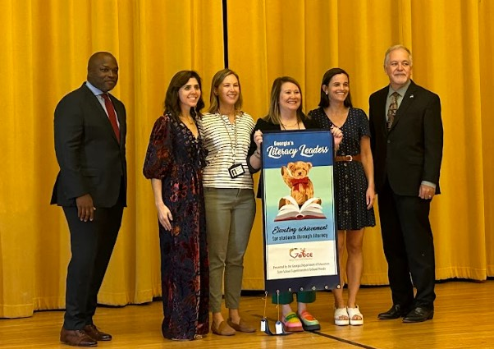
Literacy Leaders
We were honored to receive three recognitions from the GADOE related to our Georgia Milestones achievement in English Language Arts from the Spring 2024 administration!
Our 3rd grade received a Proficiency Award with 80% of students meeting proficiency.
Our 4th grade received a Proficiency Award with 85% of students meeting proficiency.
And, our 5th grade received an Outstanding Award with 94% of students meeting proficiency!

Slide 37
Thank you

